Slide 1
Energy Consumption Analysis
Domain: Energy and Sustainability

Slide 2
Problem Statement:
Project will analyze energy usage and greenhouse gas (GHG) emissions of Ontario's Broader Public Sector (BPS) organizations, leveraging a comprehensive database of reported data. We aim to identify trends, assess conservation effectiveness, and pinpoint areas for improvement,informing data-driven strategies to achieve climate change mitigation goals within the BPS.

Slide 3
Tools Used
Power-BI

Slide 4
Approaches
Data Preprocessing:
REMOVING NULL VALUES
REMOVING EMPTY COLUMNS
REMOVING COLUMN WITH MORE NULL VALUES

Slide 5
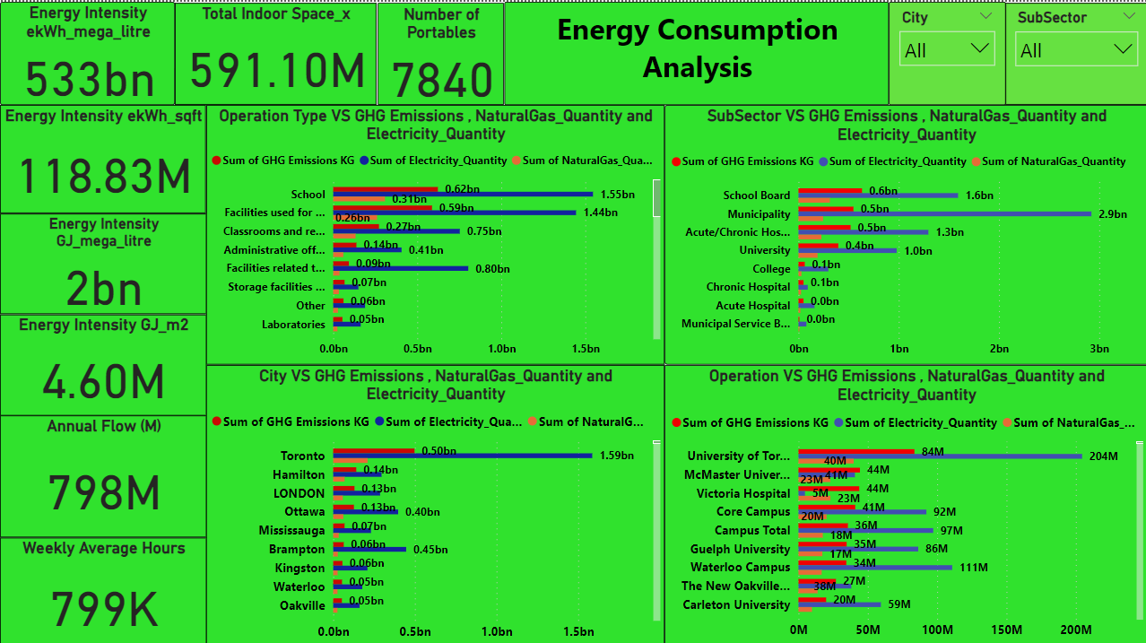
EDA Insights

Slide 6
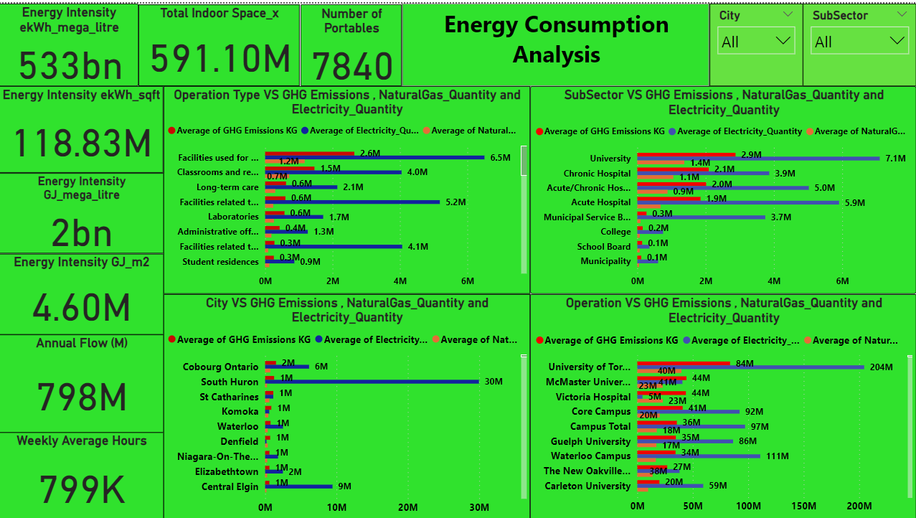
EDA Insights

Slide 7
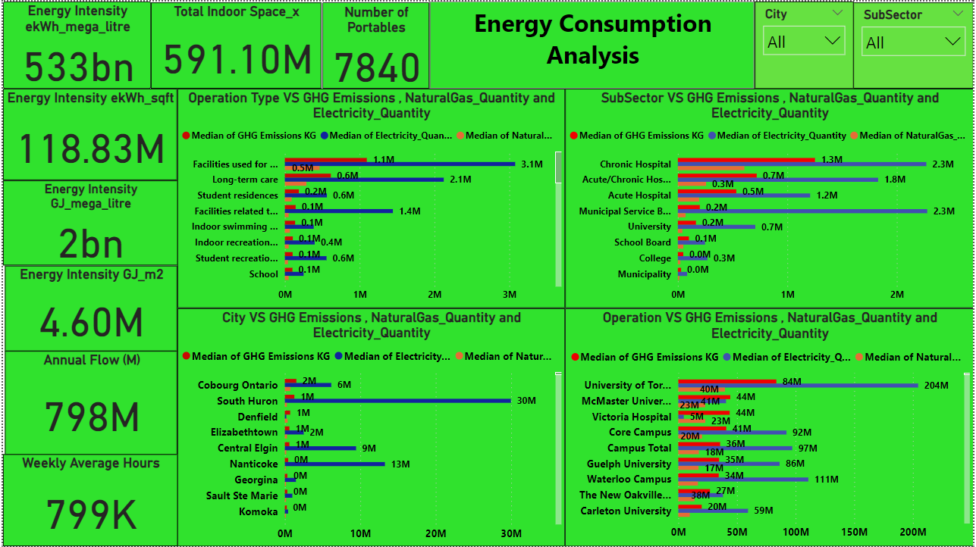
EDA Insights

Slide 8
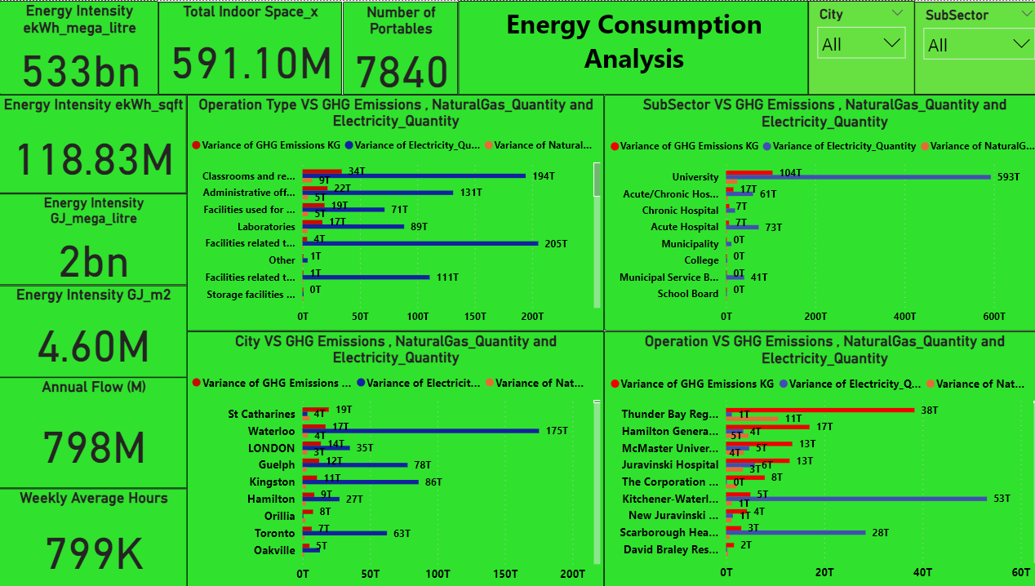
EDA Insights

Slide 9
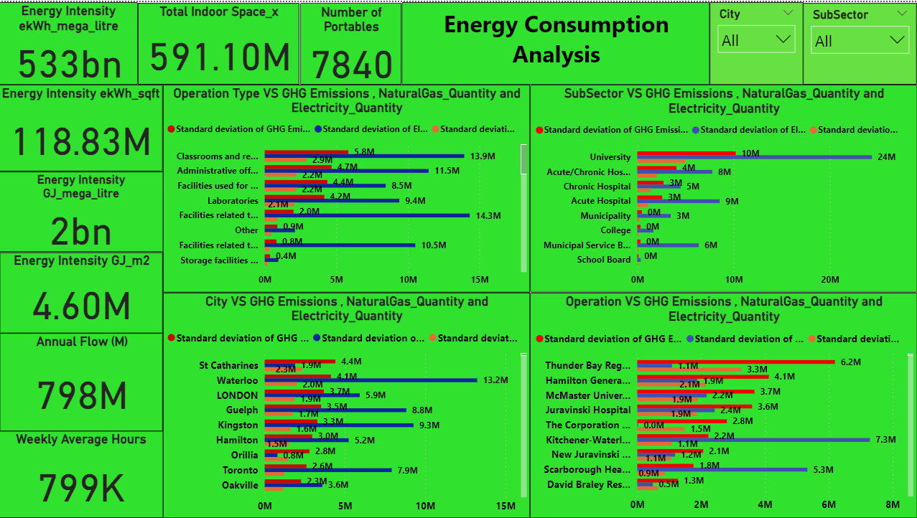
EDA Insights

Slide 10
EDA Insights
overall GHG emissions more for city toronto due to increase in the usage of Electricity_Quantity.
overall schools having high GHG emissions due usage of Number of Portables.
overall Acute/Chronic Hospital have high GHG emissions.
average GHG emissions more for city cobourg ontario due to more electricity power consumption.
average GHG emissions more for hospitals,educational institution.
Municipality having high GHG emissions due to Weekly Average Hours and Annual Flow (M) of Electricity power consumption is more.
Total Indoor Space increases power consumption also increases due to this GHG emissions is high
Education institution of city st catharines using more natural gas so GHG emissions low .

Slide 11
Conclusion/Suggestion
TO reduce greenhouse gas (GHG) emissions of Ontario's Broader
Public Sector (BPS) organizations,it should reduce the use of portables in
schools,and reduce the usage of electricity power consumption and use more
natural gas power or any other natural resources particular in educational
institutions,hospitals.

